Slide 1
Social Media Comparison Team A
Eric Slick, Peter Mansbacher, James Mortensen, Andres Dicochea

Slide 2






Problem Requirements
Must be able to scrape up to 5 brands simultaneously
Must successfully scrape information from the following sites:
Twitter
Facebook
Instagram
Tiktok
Pinterest
Youtube
Must be web-based and hosted online
Must store information into a database

Slide 3
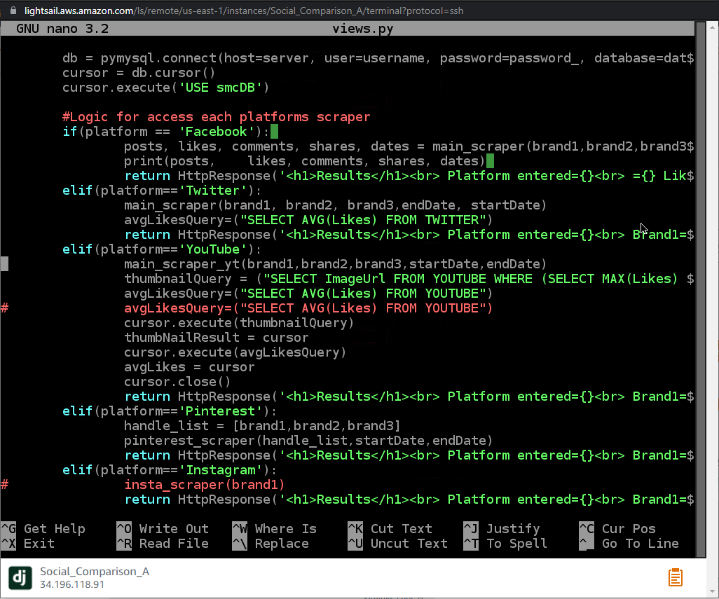
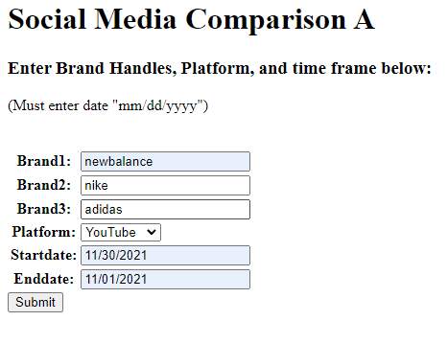
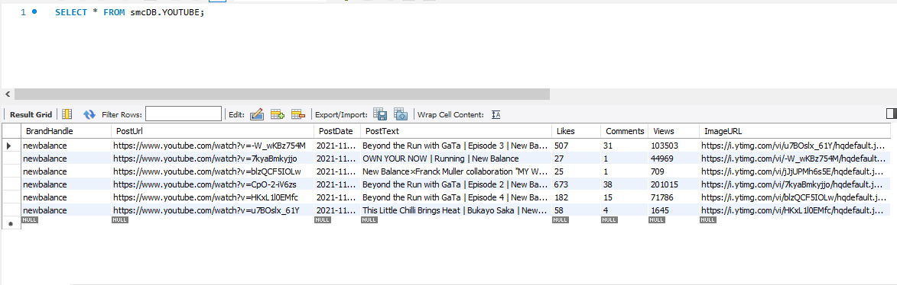
Solution

Slide 4
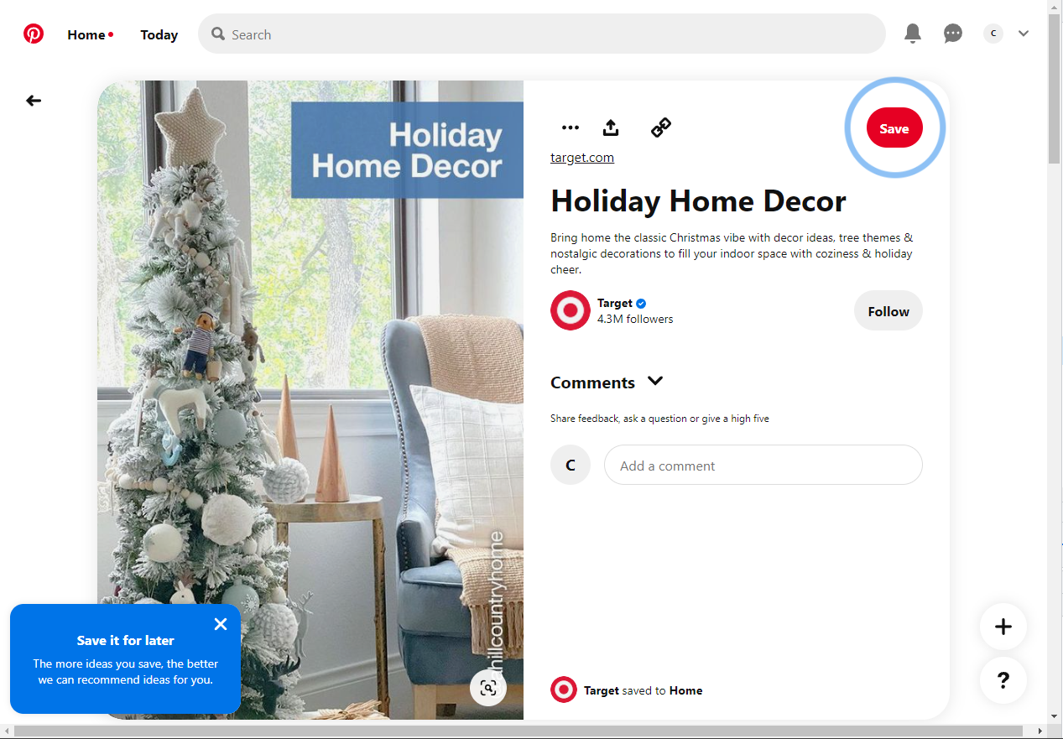
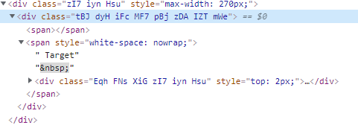
Challenges
Automated scraping detection systems
Scraping pages based on date input
Scrolling to load information
Information being hidden from the web scraping tool
Tools working differently on different machines
Dynamic identifiers for specific websites

Slide 5

Global
Impact
Simple interface helps make data highly available
People like Brandy will be easily able to compile data
Large and small businesses will benefit
Social Media platforms can use to improve their platforms

